Slide 1

DETECTING AND PREVENTING TROJANS AND KEYLOGGERS IN WINDOWS 10
PROJECT SUPERVISOR : Suja C M, MS, PhD
STUDENT NAME : MANOJ SIRIGIRI
REGISTER NO : 39110604

Slide 2
Presentation Outline
Course certificate
Objective
Introduction
What is a remote access trojan and what can it do?
Creating a trojan and how it works
How an attacker sends a payload to a target?
What is a keylogger what can it do?
Creating a keylogger using python
How to change a python script to a executable file

Slide 3
Presentation Outline
How a trojan and a keylogger communicates with the attacker?
Port mapping
How a normal windows user should suspect that he/she is attacked by a trojan?
How an anti virus works?
How power full anti virus detects trojans and keyloggers?
How can trojans be prevented?
References
Conclusions

Slide 4
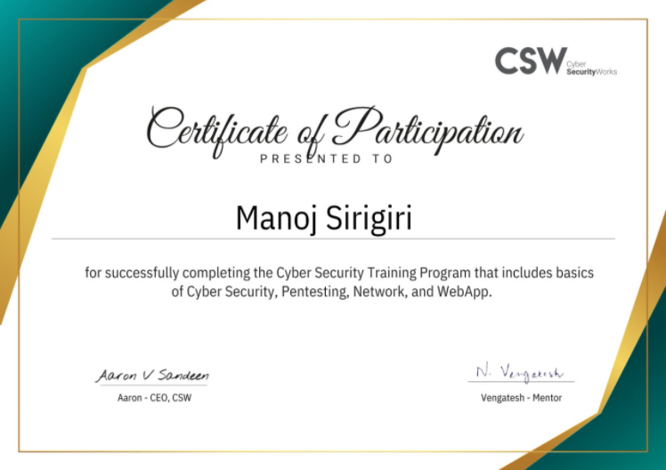
Course Certificate

Slide 5
Objective
Project Objective:
The objective of this project to detect and prevent trojans using antivirus and to create awareness to users how a remote access trojan works and what it can do.

Slide 6
Introduction
In this project I will discuss how an attacker creates and sends his malware or trojans using different social engineering techniques, and how python is used to create a keyloggers and how a normal user should get protected from these types of payloads

Slide 7
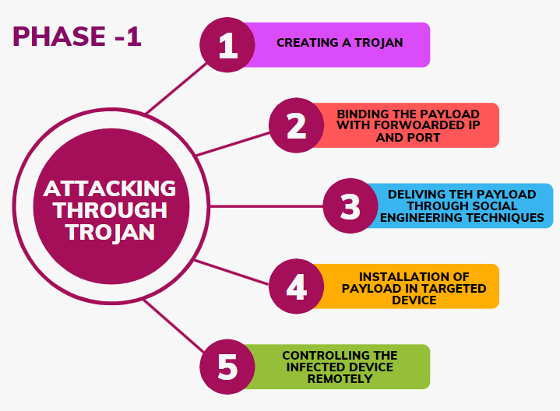


Architecture diagram

Slide 8
What is a remote access trojan
A Remote Access Trojan (RAT) is a malware program that includes a backdoor for administrative control over the target computer.
In history trojans hijacks social media in 140 countries hits 10,000 victims.
Emotet is a trojan that became famous in 2018 after the U.S. Department of Homeland Security defined it as one of the most dangerous and destructive malware.

Slide 9
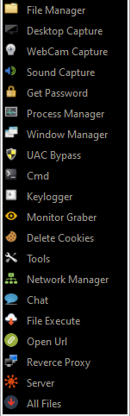
What can a trojan do
A trojan can perform many operations on attacker commands some of them are
Monitoring user behavior through KEYLOGGERS
Display monitoring
Accessing confidential information
Activating a system's webcam and recording video
Taking screenshots
Distributing viruses and other malware
Getting full control on browser, CMD, file manager
Formatting drives
Deleting, downloading or altering files and file systems

Slide 10
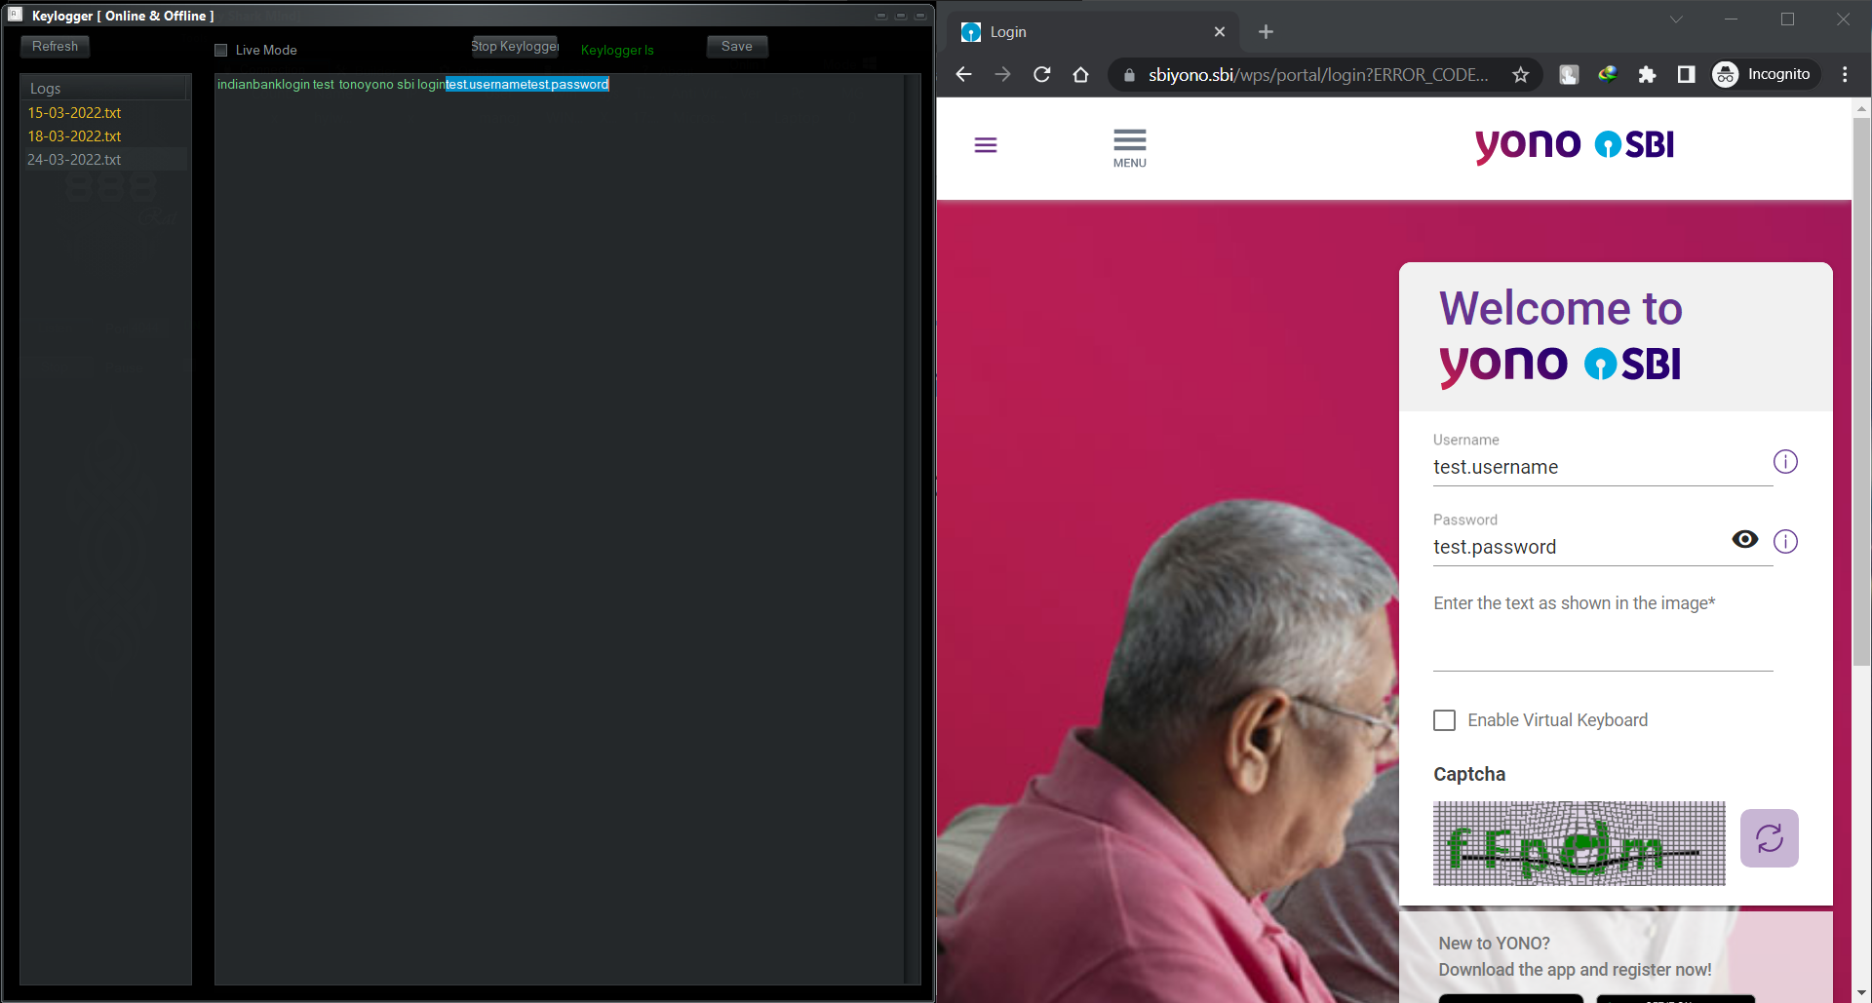
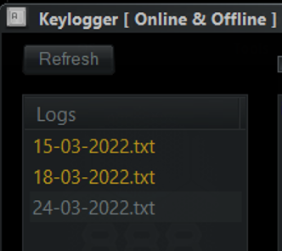
Monitoring user behavior through KEYLOGGERS

Slide 11
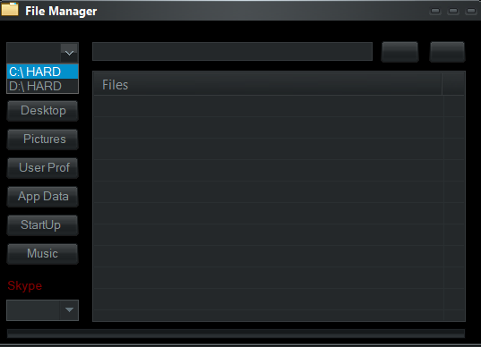
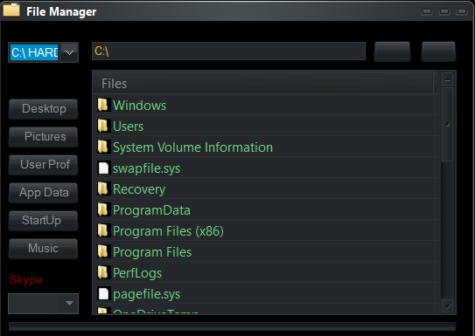
Accessing file managers and stealing the data

Slide 12
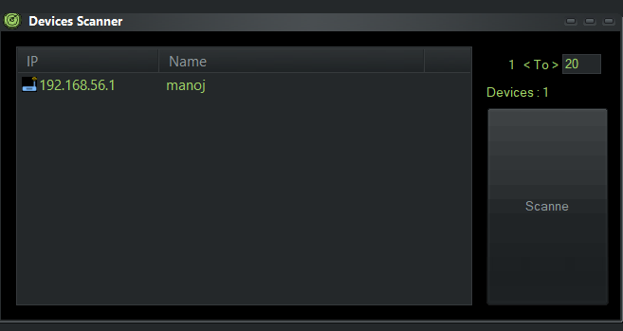
Device scanner
The information of all the members connected to the same network as that of a target is at risk of the attacker attacks the target.

Slide 13
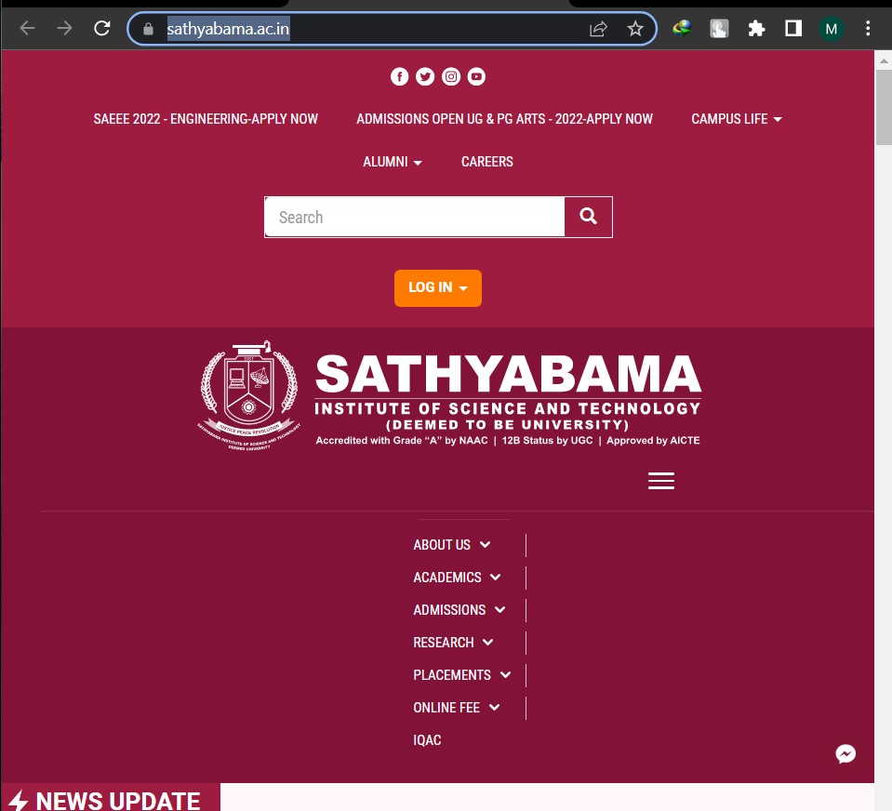
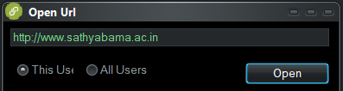
Can open any URL in victims device

Slide 14
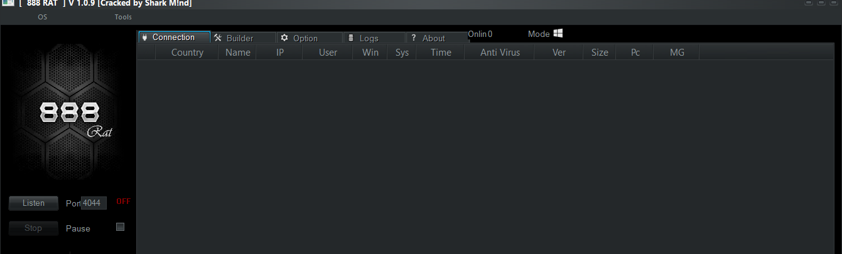
Creating a remote access trojan
Choose a preferred programming language to create a trojan according to your requirement 888 trojan works on java. It works for both windows and android

Slide 15
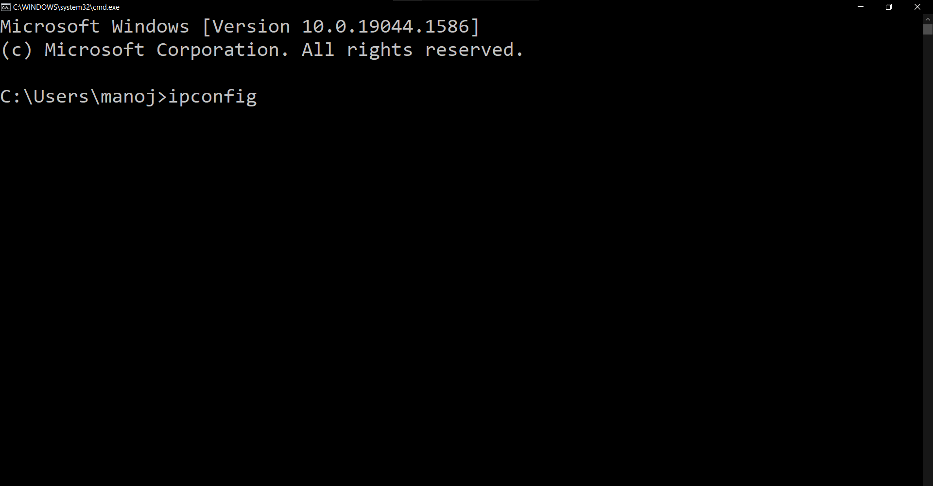
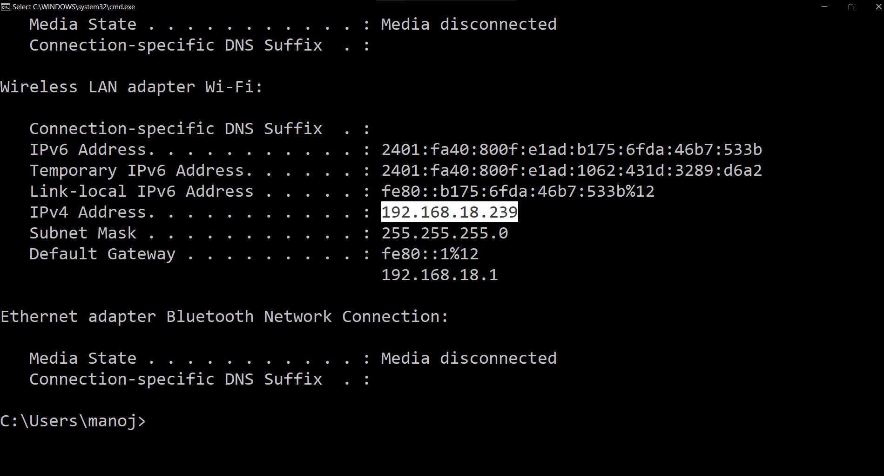
Creating a remote access trojan
Check your current local ip address in command prompt. This creates communication between the attacker and targeted user.

Slide 16
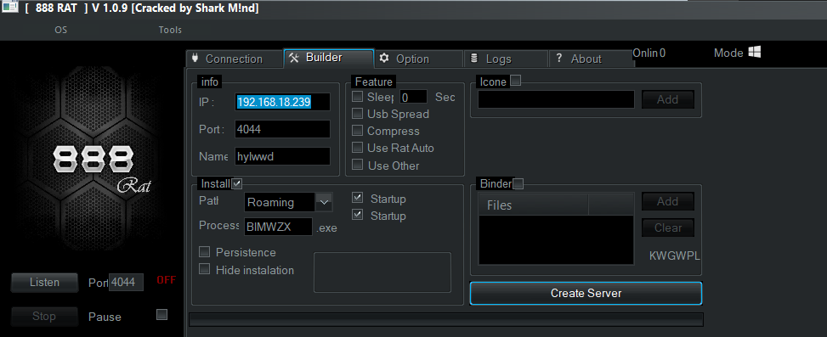
Creating a remote access trojan
Select an open port in your network to send and receive data, commands between the devices, this creates a backdoor for an attacker to re-enter any time he wants into the targeted device

Slide 17
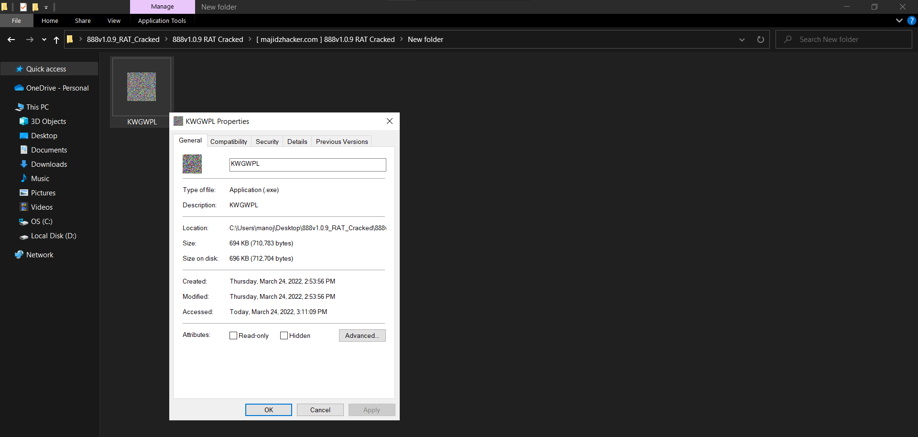
Creating a remote access trojan
A powerful trojan is created and this can be delivered to a targeted user using different social engineering techniques

Slide 18
How an attacker sends a payload to his target
Social engineering is the term used for a broad range of malicious activities accomplished through human interactions.
It uses psychological manipulation to trick users into making security mistakes or giving away sensitive information.
There are different formats an attacker can send a payload to victim
RAT can be in different formats like:
Jpg (photo format) (photo encoded with malicious code. Clicking on it will provoke the code to run)
Pdf (pdf’s encoded with malicious code. Opening it will provoke the code to run)

Slide 19
How an attacker sends a payload to his target
Exe (mostly can be seen in third party applications and mod applications, Creating a cracked version of a paid software and encoding it with a payload, users will easily install them because they are free and easy to install but forget about their security)
Html format (can hack into victims devices in the name of cookies)
Chrome extensions
RATs are usually downloaded invisibly with a user-requested program such as a game -- or sent as an email attachment. This directly runs the encoded malicious code to give administrator control to the application

Slide 20
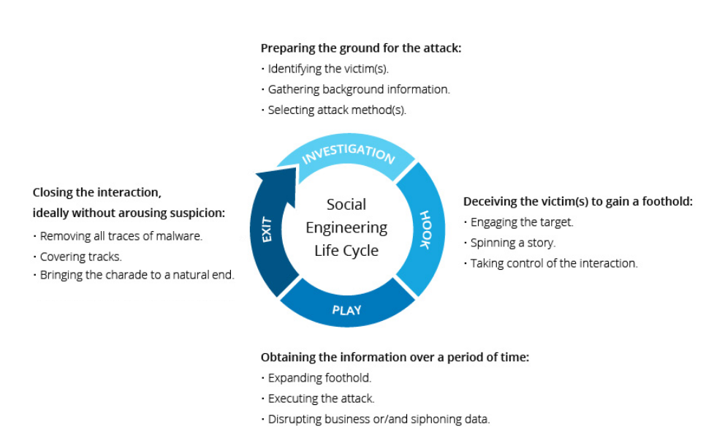
How an attacker sends a payload to his target

Slide 21
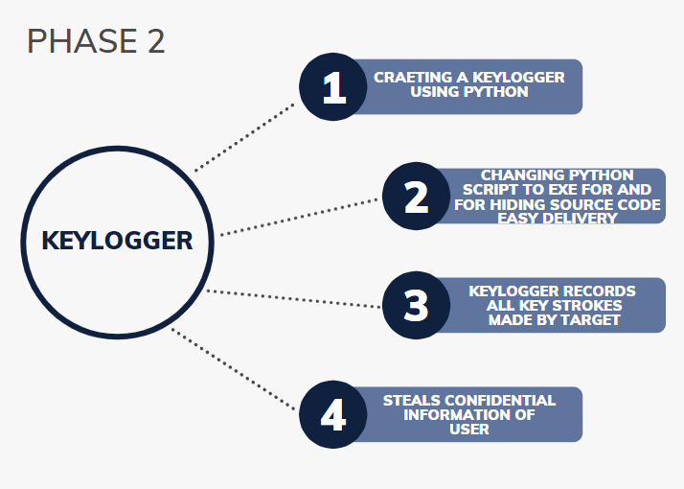
Architecture diagram

Slide 22
What is a keylogger, What can it do ?
Keyloggers are a type of monitoring software designed to record keystrokes made by a user.
Data captured by keyloggers can be sent back to attackers via email or uploading log data to predefined websites, databases, or FTP servers. If the keylogger comes bundled within a large attack, attacker might simply remotely log into a machine to download keystroke data.

Slide 23
Creating a keylogger using python
The pynput library in python allows one to control and monitor/listen to your input devices such as they keyboard
The pynput.keyboard allows you to control and monitor the keyboard
The passwords and credit card numbers you type, the webpages you visit – all by logging your key strokes
The software is installed on your computer, and records everything you type. Then it sends this log file to a server, where the cybercriminals wait to make use of all this sensitive information

Slide 24
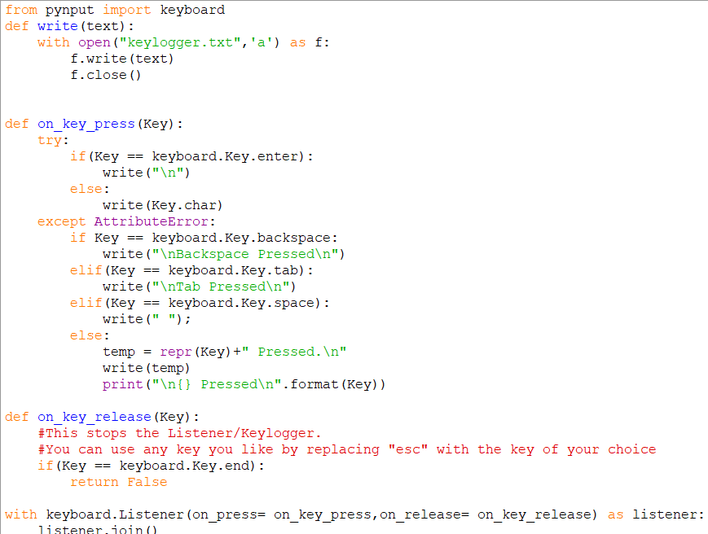

Slide 25

How to change a python script to a executable file
Nullsoft scriptable install system converts .py files to executable applications
Converting a payload script to an exe makes the malware easy to deliver to various users using different social engineering techniques

Slide 26
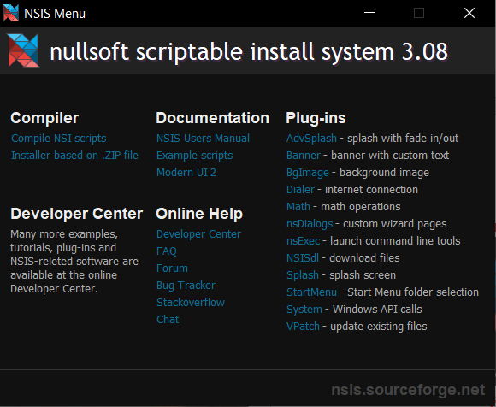
How to change a python script to a executable file
The interface of this software looks like this

Slide 27
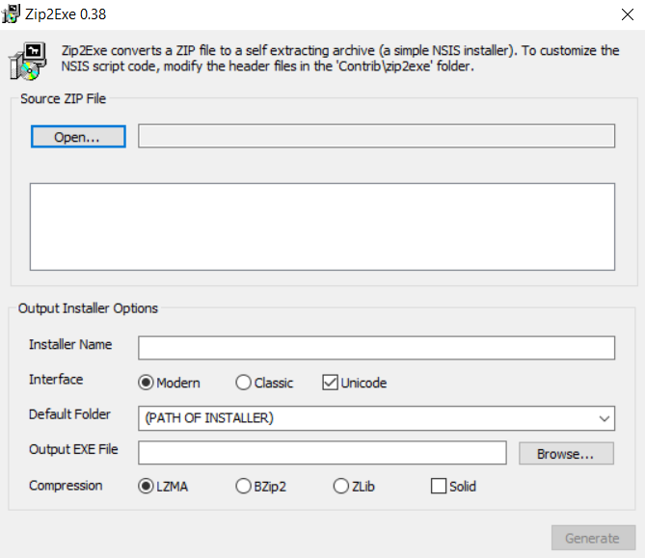
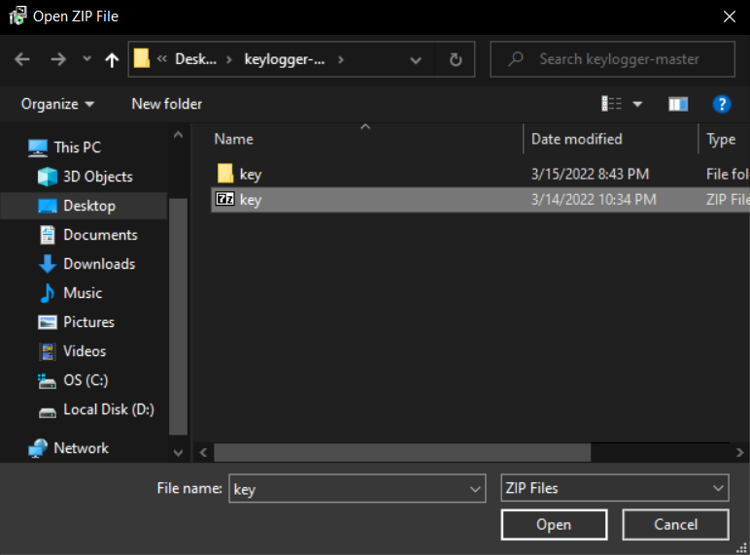
How to change a python script to a executable file
Should convert my .py file into a zip file to use the installer

Slide 28
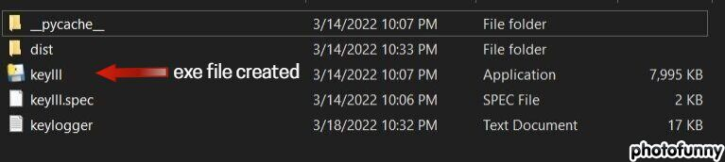
How to change a python script to a executable file
NSIS will create an executable file. This process makes the attacker code hidden and undetectable
Attacker can send this application to his targets to monitor them

Slide 29
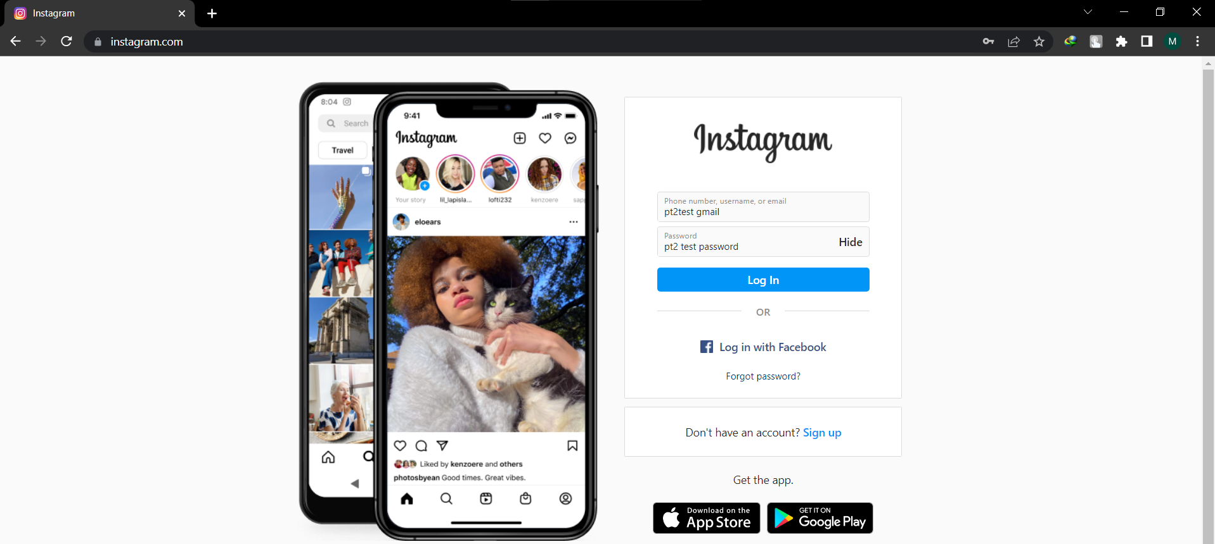
For example if a target uses his device the application stores the keystrokes and sends it to the attacker

Slide 30

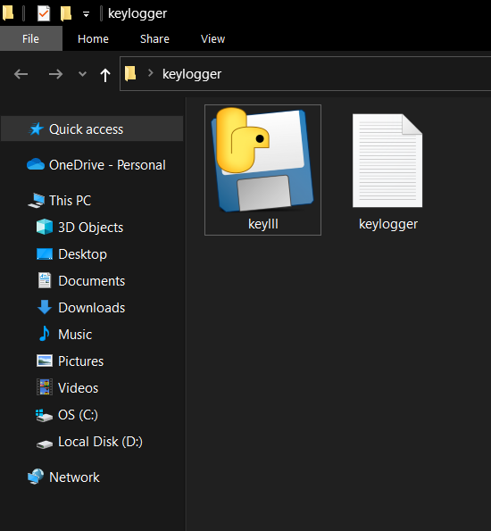
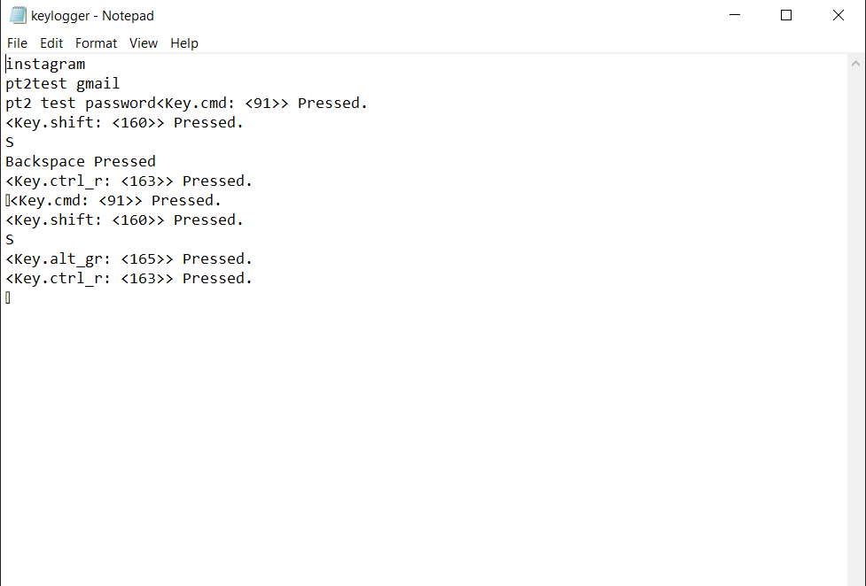
Application creates a log file and stores the information

Slide 31
How a trojan and a keylogger communicates with the attacker?
Backdoor Trojans are malicious software programs designed to grant unwanted access for a remote attack.
Remote attackers can send commands or leverage full control over a compromised computer. Backdoor malware and viruses bypass authentication procedures to access systems and to prevent their presence from being detected.
The designation as a Trojan indicates that this form of attack does not reproduce by spreading to additional files after infection.

Slide 32
How a trojan and a keylogger communicates with the attacker?
Once a Trojan gains a foothold in a system, it adds itself to the computers startup routine so that rebooting the computer will not permanently end malicious processes.
Transfer of data packets, remote commands done through a back door, An attacker can enter into the victim’s device anytime he wants through the back door he created.

Slide 33
How a trojan and a keylogger communicates with the attacker?
The RAT created here is encoded with a back door with my IP address and an open port for the transfer for data packets and remote commands, this process works only in a local network
Port forwarding should be done to access other devices using trojan.

Slide 34
Port forwarding
The attacker uses port forwarding to access victim’s computer if the device is not connected to his local network.
Port forwarding is achieve by creating an association called a map between a router’s public, wide area network (WAN) Internet protocol address (IP address) and a private, local area network (LAN) IP address for a device on that private network.

Slide 35
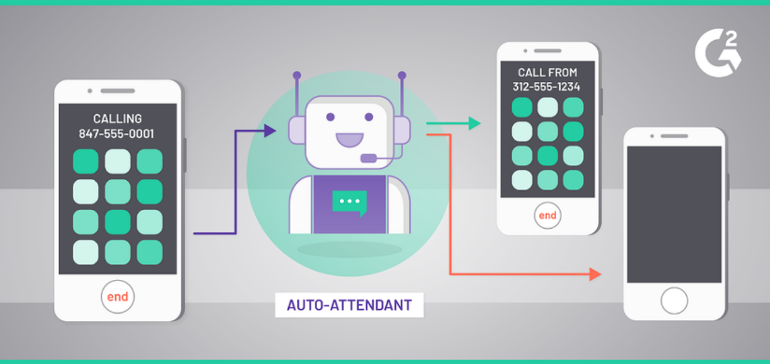
Port forwarding
In simple terms port forwarding is just like call forwarding

Slide 36
Port forwarding
Once connected, your device, laptop, cell phone, tablet, etc. router will assign an IP address on that network through a process called DHCP (Dynamic Host Configuration Protocol). That IP address is unique to your device on the network, which is important for the router in identifying the device.
Anything a user browses will send connection request from your device to the router, detailing your device’s IP address and an associated port for the request. Your device is the host or source for the connection.

Slide 37
Port forwarding
Port Forwarding sets up public services on your network such as web servers, FTP servers, e-mail servers, or other specialized Internet applications. When users send this type of request to your network via the Internet, the router will forward these requests to the appropriate computer.
Port forwarding is needed when a machine on the Internet needs to initiate a connection to a machine that's behind a firewall or NAT router.

Slide 38
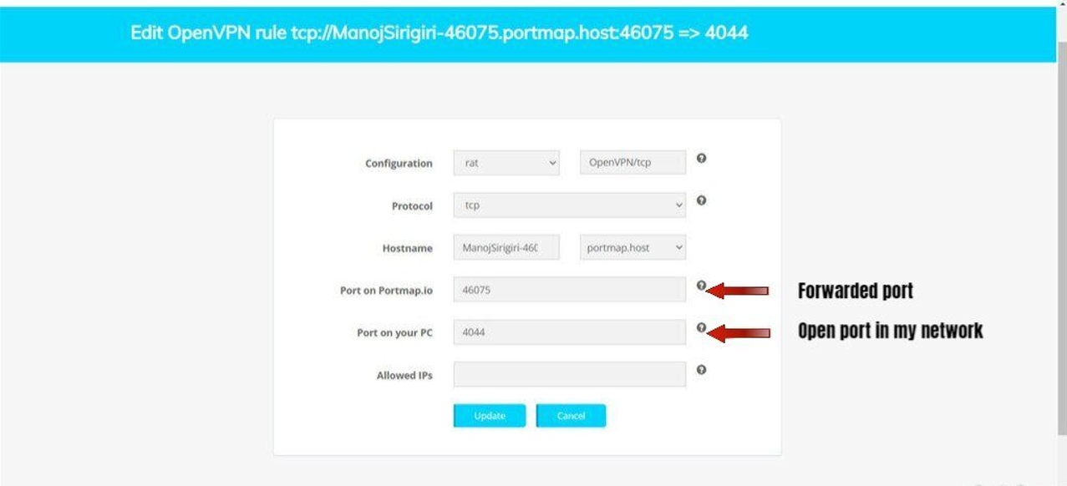
Port forwarding
In this case I used portmap.io and OpenVPN for port forwarding

Slide 39
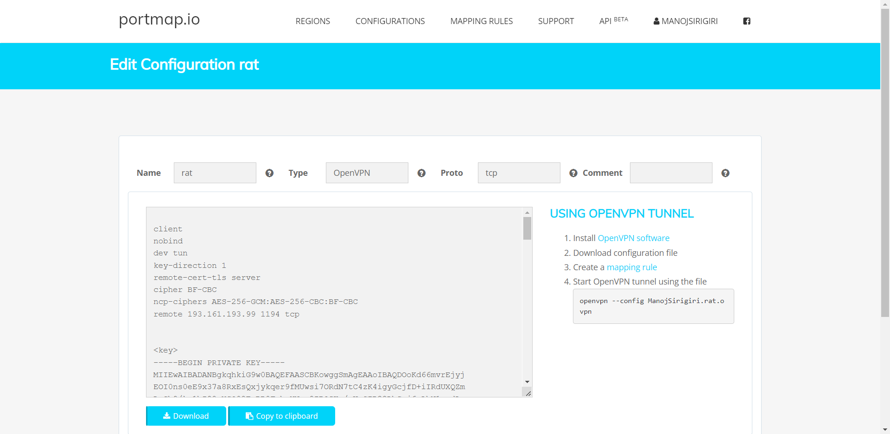
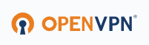
Port forwarding
Then I downloaded the configuration file provided by portmap.io and now I am ready to use it via and self hosted vpn.

Slide 40
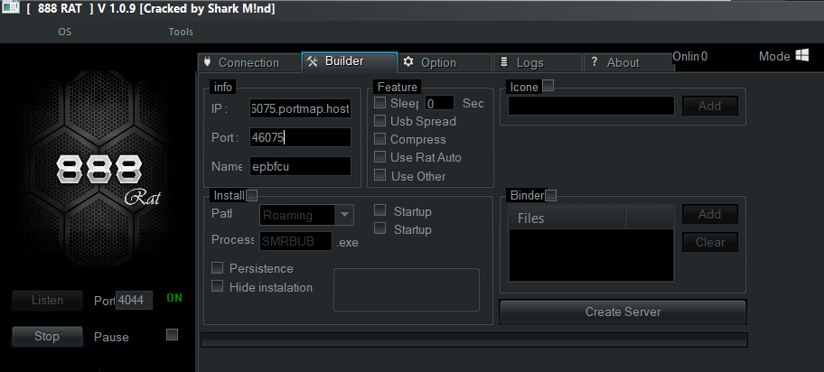
Port forwarding
Attackers use forwarded port as their open port and listens the connection via actual open port in their local network

Slide 41
How a normal windows user should suspect that he/she is attacked by a trojan
One should suspect they are attacked by a malware if
Their computer is slowing down
Annoying ads are displayed
Crashes
Pop-up messages
Internet traffic suspiciously increases
Their browser homepage changed without your input
Unusual messages show unexpectedly

Slide 42
How a normal windows user should suspect that he/she is attacked by a trojan
Their security solution is disabled
Their friends say they receive strange messages from them
Unfamiliar icons are displayed on your desktop
Unusual error messages
When they can’t access the Control Panel
suspicious shortcut files
Taking too much time to bootup
Consumes more ram in the device

Slide 43
How a normal windows user should suspect that he/she is attacked by a trojan
Automatically downloading files from browser
A lot of spam in your email
Problems with your laptop’s battery

Slide 44
How an antivirus works
Antivirus is a kind of software used to prevent, scan, detect and delete viruses from a computer. Once installed, most antivirus software runs automatically in the background to provide real-time protection against virus attacks.
Antivirus software begins operating by checking your computer programs and files against a database of known types of malwares. Since new viruses are constantly created and distributed by hackers, it will also scan computers for the possibility of new or unknown type of malware threats.

Slide 45
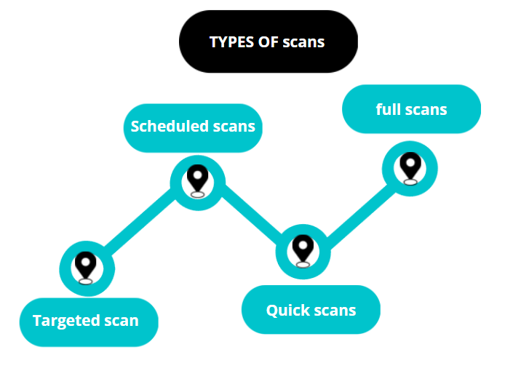
How an antivirus works

Slide 46
How an antivirus works
Manual scanning: Manual scanning means you can start a scan anytime you want.
On-access scanning: This type of scanning begins whenever you open the antivirus software, usually upon device startup. The advantage of on-access scanning is that it prevents you from forgetting to run a scan.

Slide 47
How an anti virus works
Scheduled scans: Some software gives you the option to schedule scans for regular times each day or week. Like on-access scans, scheduled scans are a handy way to make sure you remember to scan your device regularly.
Quick scans: Quick scans check commonly used areas of a device, such as temporary files, the operating system directory, and the computer memory. Because they don’t scan everything on your device, they typically take less than 30 minutes to complete.

Slide 48
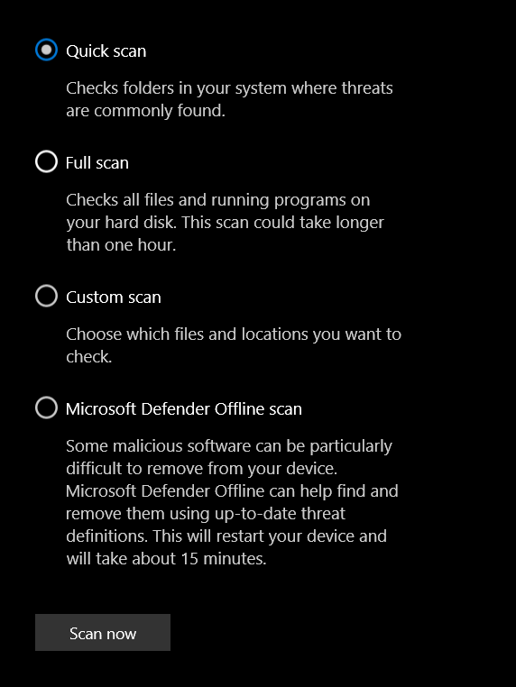
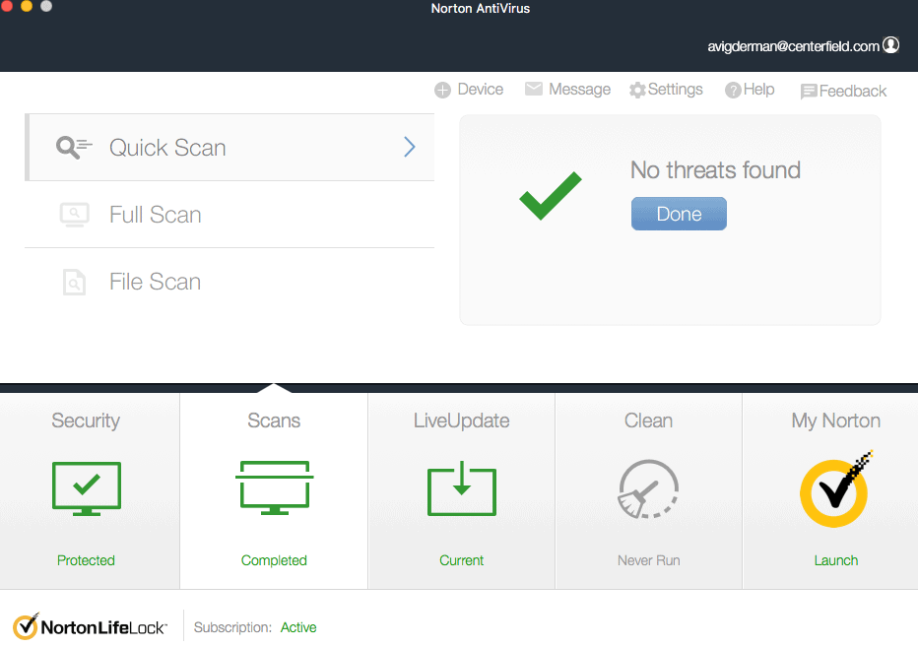
How an anti virus works

Slide 49
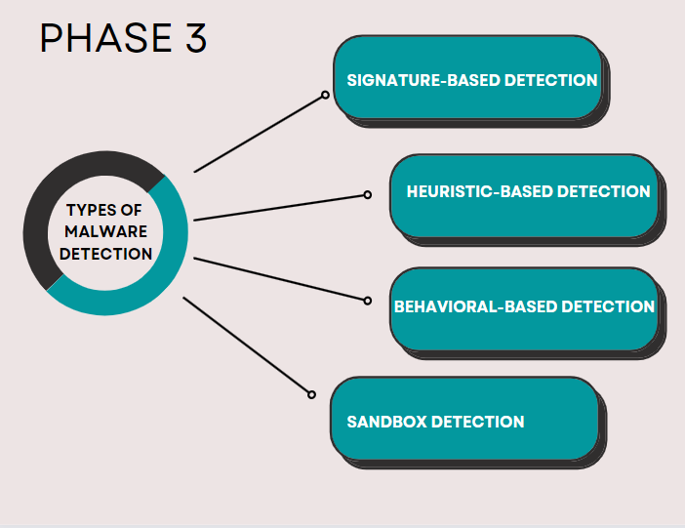
Architecture diagram

Slide 50
How power full antivirus detects trojans and keyloggers?
There are a few ways that your antivirus can detect a Trojan:
Signature-based detection :- Every program has a signature. A signature is nothing more than a binary pattern. When an antivirus scans a file you downloaded, it looks at its signature and compares it against an extensive database of virus signatures. If it is a known malicious signature, it will warn you immediately.

Slide 51
How power full antivirus detects trojans and keyloggers?
Heuristic-based detection :- Analyzes behavior and patterns of code to see if your file or program is infected. Any Suspicious code is run in a runtime virtual environment to test it more. This method can find new viruses that are not in your antivirus database.
Behavioral-based detection :- Your antivirus is continually looking at your pc. If one of your programs behaves weirdly and is doing harmful things and asking for more read and write permissions, your antivirus will see that and let you know.

Slide 52
How power full antivirus detects trojans and keyloggers?
Sandbox detection :- If your antivirus doesn’t know for sure if a program or file has a virus and it suspects something, it will run it in a sandbox. Similar to behavioral-based detection, Sandbox detection will let your file run in a virtual machine and see how it behaves.
Analyzing system crashes
Checking the startup applications whether they are consuming more ram and network

Slide 53
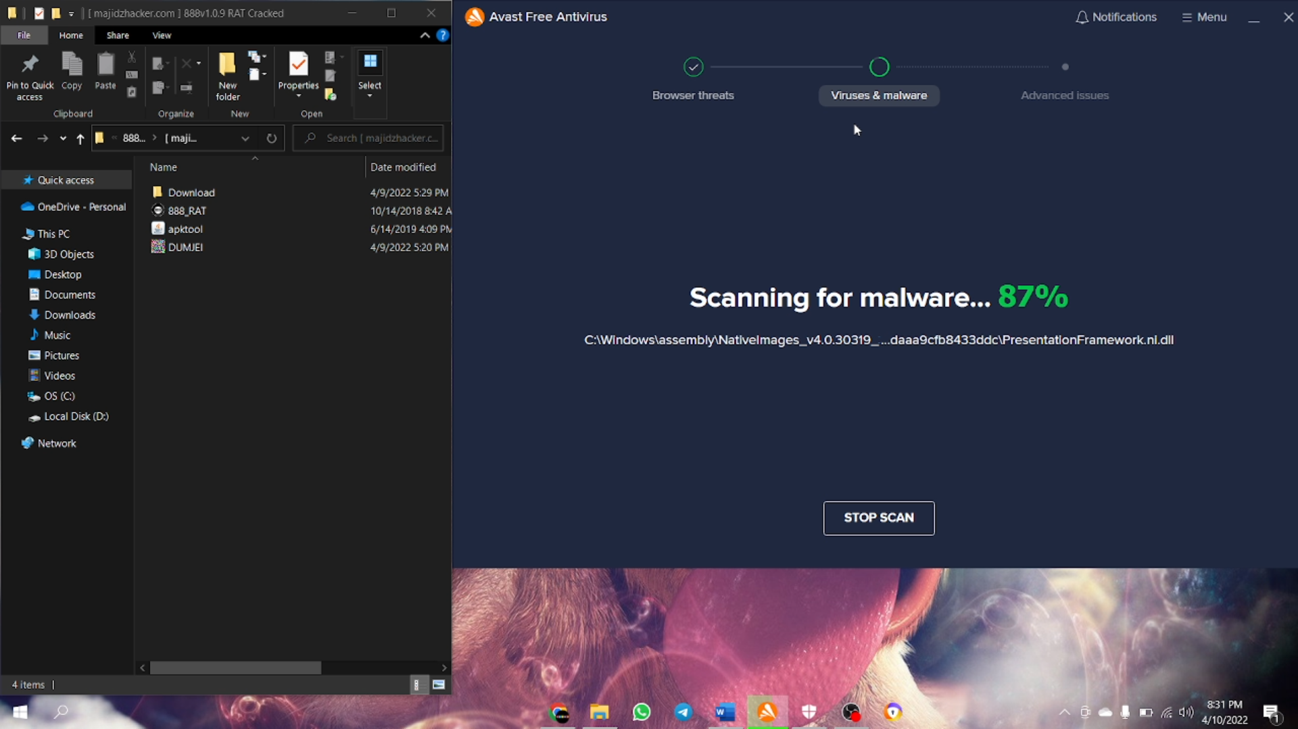
How power full antivirus detects trojans and keyloggers?
I am using Avast antivirus software to detect trojans in my computer

Slide 54
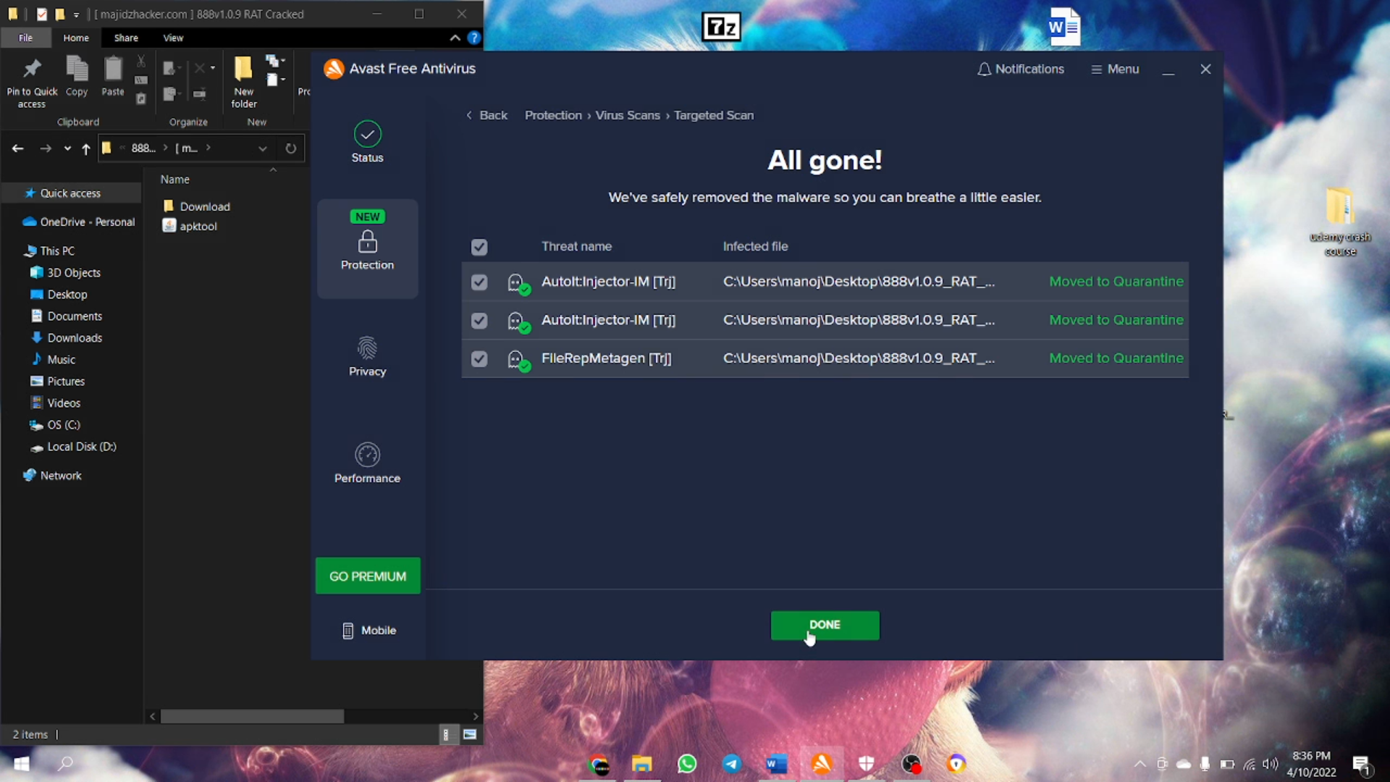
How power full antivirus detects trojans and keyloggers?
Successfully detected and removed trojans from my device

Slide 55
How can trojans be prevented?
Prevention is the best method. You can make sure you will not be infected. A new trojan will not be discovered until it runs, and if it runs, it can steal your personal information before your antivirus detects it. Here are some things that a user can do:
Use an antivirus. It provides an extra set of on your internet browsing. This can prevent you from doing something stupid that I will regret later

Slide 56
How can trojans be prevented?
Keep your system up to date. Even with an antivirus in place, you have to keep your Operating system and software up to date. Windows or Mac Os are continually trying to make their OS more secure.
Use strong passwords for all of your accounts. If you can’t remembering or create strong passwords, use a password manager

Slide 57
How can trojans be prevented?
Don’t download and install software from suspicious websites. Trojans are good software on the surface. Inside they contain malicious code that can harm you! So stay safe and download and install software only from the publisher’s website.
Watch out for clickbait emails. Email is an excellent form of communication but also can be used to trick you in downloading infected files. If you don’t know the sender, do yourself a favor and delete the email!

Slide 58


CONCLUSION
I hope that my presentation will be helpful to improve the knowledge about cyber security and to overcome several security loopholes on their computer operation. Also it helps to spread awareness about emerging security threats.
PREVENTION IS BETTER THAN CURE
BE AWARE OF Cybercriminals, THEY take advantage of your trust, fear and greed.

Slide 59
REFERENCES
Port Forwarding by Zack busch
https://portmap.io/ provides the port mapping services
https://openvpn.net/ (OpenVPN provides self hosted Virtual private network to users)
Usages of Selected Antivirus Software in Different Categories of Users in selected Districts by JEGET

Slide 60
THANK YOU

